Slide 1
Material Handling Systems
CH # 5

Slide 2
5.1 Introduction
The design of the material handling system is an important component of the facilities design problem. There exists a strong relationship between the layout design and the material handling design function.
5.2 Scope & Definition of Material Handling
In a typical manufacturing facility:
25% of the work-force is used in material handling
55% of the factory floor is reserved for it
87% of the production time!
It may represent 15% to 70% of the total cost generated in the company Certainly, material handling is one of the first places to look for cost reduction.
Material handling is also one of the first places to look for quality improvements. It has been estimated that between 3 and 5% of all material handled becomes damaged.
Material handling is a means by which total manufacturing costs are reduced through reduced inventories, improved safety, reduced pilferage, and improved material control.

Slide 3
5.2.1 Definition
1. Material handling is the art and science of moving, storing, protecting, and controlling material.
2. Material handling means providing the right amount of the right material, in the right condition, at the right place, at the right time, in the right position, in the right sequence, and for the right cost, by using the right method(s).
The definition defines the essentials of MHF which are
Right Amount
Right Material
Right Condition.
Right Sequence
Right Orientation
Right Place
Right Time
Right Cost

Slide 4
5.3 Material Handling Principles
The material handling principles provide concise statements of the fundamentals of material handling practice. Condensed from decades of expert material handling experience, not unlike the material handling equation, they provide guidance and perspective to material handling system designers
The ten MHP recognized by the collage Industrial Council on Material Handling.
1. Planning Principle. A plan is prescribed course of action that is defined in advance of implementation. In its simplest form, a material handling plan defines the material (what) and the moves (when and where); together they define the method (how and who).
2. Standardization Principle. Standardization means less variety and customization in the methods and equipment employed.
3. Work Principle. The measure of work is material flow (volume, weight, or count per unit of time) multiplied by the distance moved.
4. Ergonomic Principle. Ergonomics is the science that seeks to adapt work or working conditions to suit the abilities of the worker.

Slide 5
5. Unit Load Principle. A unit load is one that can be stored or moved as a single entity at one time, such as a pallet, container, or tote, regardless of the number of individual items that make up the load.
6. Space Utilization. Space in material handling is three-dimensional and therefore is counted as cubic space.
7. System Principle. A system is a collection of interacting and/or interdependent entities that form a unified whole.
8. Automation Principle. Automation is a technology concerned with the application of electromechanical devices, electronics, and computer-based systems to operate and control production and service activities. It suggests the linking of multiple mechanical operations to create a system that can be controlled by programmed instructions.
9. Environmental Principle. Environmental consciousness stems from a desire not to waster natural resources and to predict and eliminate the possible negative effects of our daily actions on the environment.
10. Life-Cycle Cost Principle. Life-cycle cost include all cash flows that will occur from the time the first dollar is spent to plan or procure a new piece of equipment, or to put in place a new method, until that method and/or equipment is totally replaced.

Slide 6
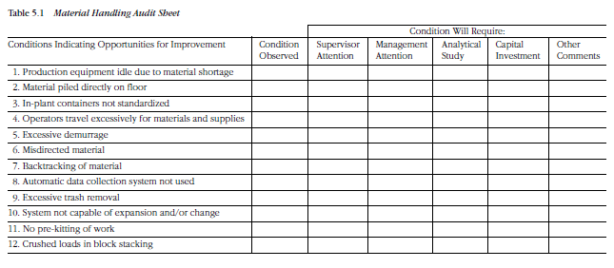
Based on Principals the Material Handling checklist is made.
Q. Make a check list of Material handling of UMT Examination Department

Slide 7
5.4 Designing Material Handling System
In designing new or improved material handling systems, the six-phased are
1. Define the objectives and scope for the material handling system.
2. Analyze the requirements for moving, storing, protecting, and controlling material.
3. Generate alternative designs for meeting material handling system requirements.
4. Evaluate alternative material handling system designs.
5. Select the preferred design for moving, storing, protecting, and controlling material.
6. Implement the preferred design, including the selection of suppliers, training of personnel, installation, debug and startup of equipment, and periodic audits of system performance.

Slide 8
Developing Alternative Material Handling System Design
To stimulate the development of alternatives the, the ideal systems approach consists of four phase.
Aim for the theoretical ideal system.
Conceptualize the ultimate ideal system.
Design the technology workable ideal system.
Install the recommended system.
Developing Alternative Material Handling System Design

Slide 9
1. Why
a. Is handling required?
b. Are operations to be performed as they are?
c. Are the operations to be performed in the given sequence?
d. Is material received as it is?
e. Is material shipped as it is?
f. Is material packaged as it is?
2. What
a. Is to be moved?
b. Data are available and required?
c. Alternatives are available?
d. Are the benefits and disbenefits (costs) for each alternative?
e. Is the planning horizon for the system?
f. Should be mechanized/automated?
g. Should be done manually?
h. Shouldn’t be done at all?
i. Other firms have related problems?
j. Criteria will be used to evaluate alternative designs?
k. Exceptions can be anticipated?

Slide 10
3. Where
a. Is material handling required?
b. Do material handling problem exist?
c. Should material handling equipment be used?
d. Should material handling responsibility exist in the organization?
e. Will future change occur?
f. Can operations be eliminated, combined, simplified?
g. Can assistance be obtained?
h. Should material be stored?
4. When
a. Should material be moved?
b. Should I automate?
c. Should I eliminate?
d. Should I expand (contract)?
e. Should I consult vendors?
f. Should a postaudit of the system be performed?

Slide 11
5. How
a. Should material be moved?
b. Do I analyze the material handling problem?
c. Do I sell everyone involved?
d. Do I learn more about material handling?
e. Do I choose from among the alternatives available?
f. Do I measure material handling performance?
g. Should exceptions be accommodated?
6. Who
a. Should be handling material?
b. Should be involved in designing the system?
c. Should be involved in evaluating the system?
d. Should be involved in installing the system?
e. Should be involved in auditing the system?
f. Should be invited to submit equipment quotes?
g. Has faced a similar problem in the past?

Slide 12
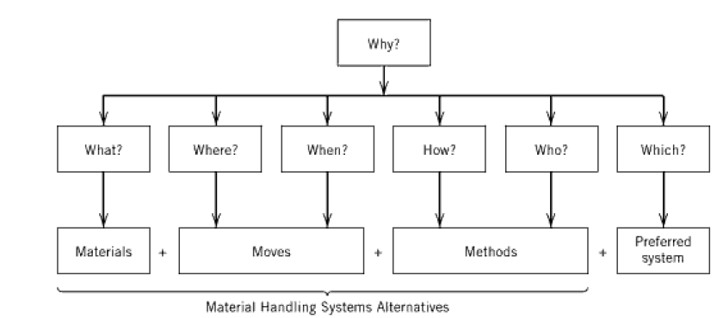
7. Which
a. Operations are necessary?
b. Problems should be studied first?
c. Type equipment (if any) should be considered?
d. Materials should have real-time control?
e. Alternative is preferred?

Slide 13

The combination of material characteristics and move or flow requirements is referred to as material flow. Hence, to develop material flow system requirements, one should focus on the material to be handled, stored, and controlled and the flow or throughput requirements for the system.
To develop material flow system requirements, one should focus on the material to be handled, stored, and controlled and the flow or throughput requirements for the system.
Material flow is transformed to material handling by the method of handling, storing, and controlling the material.
Material Handling had advantages and disadvantages.
An alternative method of representing questioning attitude in designing material handling systems is given by

Slide 14
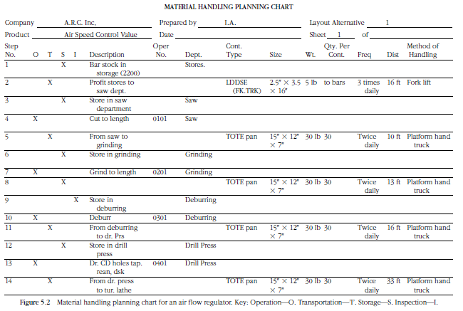
Material Handling Planning Chart
To gather information pertaining to material handling and
To analyze the data in order to develop alternative solutions.

